Slide 1



PROJECT ON
Exploratory Data Analysis on Washing Machine Market
Presented by:
P. Sridhar
Batch No: 450
Innomatics Research
Labs, Dilsuknagar

Slide 2
ABOUT ME
I am PUTNALA SRIDHAR
I Completed my graduation in the stream of B.sc (MSDS) and Degree from Govt degree college of khairatabad.
Linkedin : https://www.linkedin.com/in/putnala-sridhar-067077370/

Slide 3
AGENDA
Business Problem
Problem Statement
Objectives
Dataset Overview
Data Preparation & Cleaning
EDA Visualizations
Conclusion & Future Scope
Applications & Recommendations

Slide 4
Business Problem
The washing machine market is highly competitive with multiple brands and product types.
Customers often struggle to choose the right product
Customers are influenced by price, brand reputation, machine type, and capacity.
Businesses lack clarity on what factors drive customer engagement (reviews).

Slide 5
Problem Statement
Analyze washing machine product data to identify:
Pricing trends
Brand influence
Customer engagement patterns
Determine whether factors like price, brand, and machine type impact customer reviews.

Slide 6
Objectives
Understand the overall structure of the dataset
Clean and prepare data for analysis
Perform Univariate, Bivariate, and Multivariate analysis
Apply statistical test cases to validate insights

Slide 7
Dataset Overview
Source: E-commerce product listings
Total Columns: 9
Rows: ~600 products
Columns:
Product_Name – Name of the washing machine, Brand – Manufacturer brand, Capacity_kg – Load capacity in kg
Machine_Type – Semi / Fully Automatic, Load_type – Top Load / Front Load, Color – Product color
Price – Price in INR, Discount_% – Discount percentage, Reviews_Count – Number of customer reviews

Slide 8
Data Cleaning
Data Cleaning Steps
Handled missing values in:
  Price
  Discount
  Capacity
  Reviews_Count
Converted price and discount into numerical format
Removed empty Machine_Type values
Ensured consistent data types

Slide 9
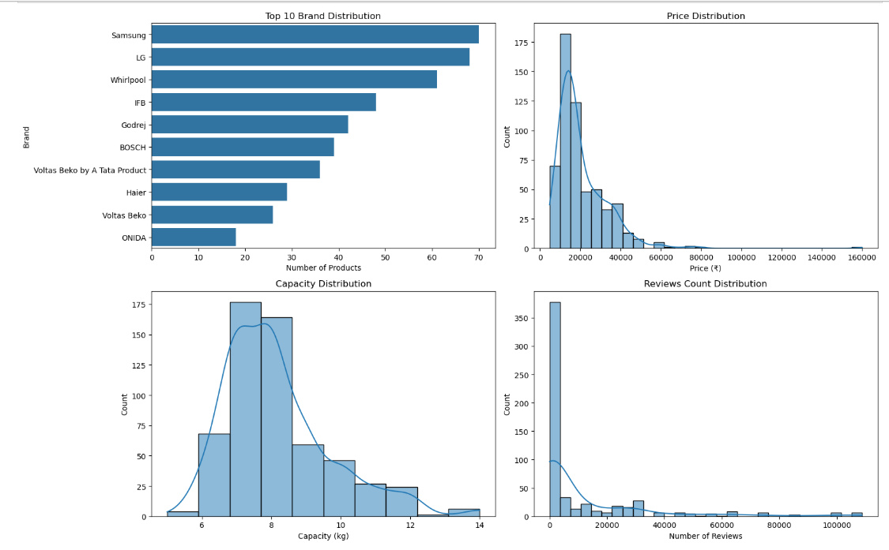
Univariate visualization

Slide 10
Univariate Insights
A few major brands dominate the washing machine market with the highest number of products.
Most washing machines are available in the mid-price range.
The majority of products have a capacity between 6 to 8 kg.
This capacity range is suitable for average household needs.
Customer reviews are uneven, with only a few products receiving very high engagement.

Slide 11
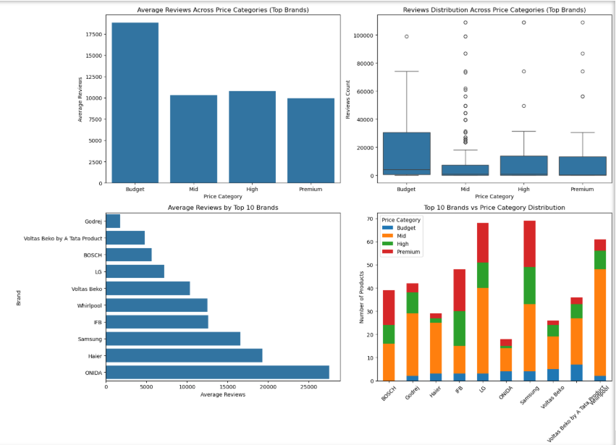
Bivariate visualization

Slide 12
Bivariate Insights
Budget-priced washing machines receive higher average reviews and stronger customer engagement.
Higher price categories do not consistently result in more customer reviews.
Review counts vary significantly across brands, showing strong brand influence.
Brands follow different pricing strategies across budget, mid, high, and premium segments.

Slide 13
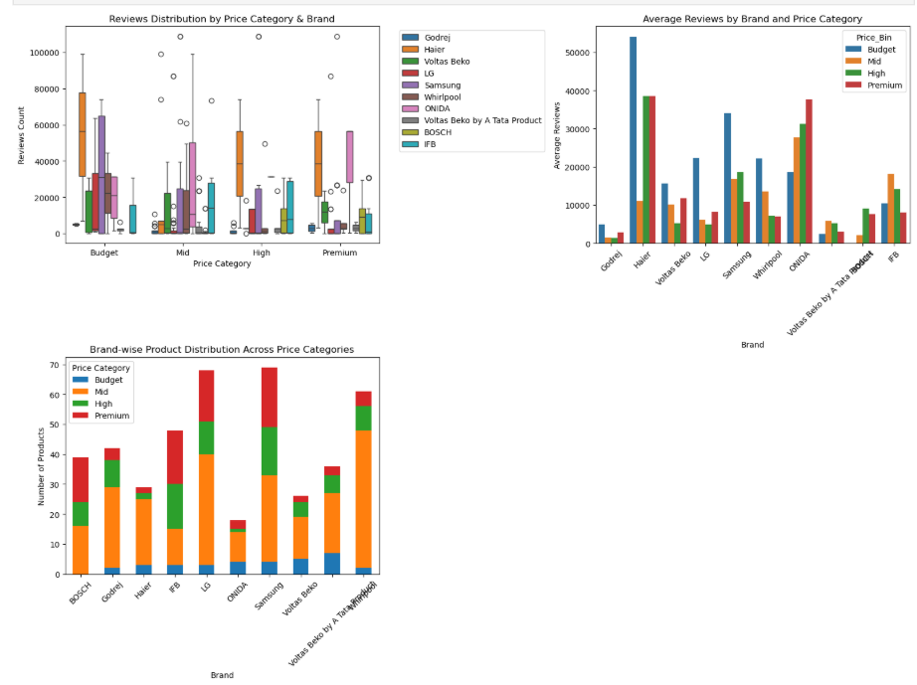
Multivariate visualizations

Slide 14
Multivariate Visualization Insights
Customer reviews vary across brands and price categories.
Some brands receive high reviews even in budget and mid-price segments.
Brand reputation influences reviews more than price.
Brands follow different product and pricing strategies across segments.

Slide 15
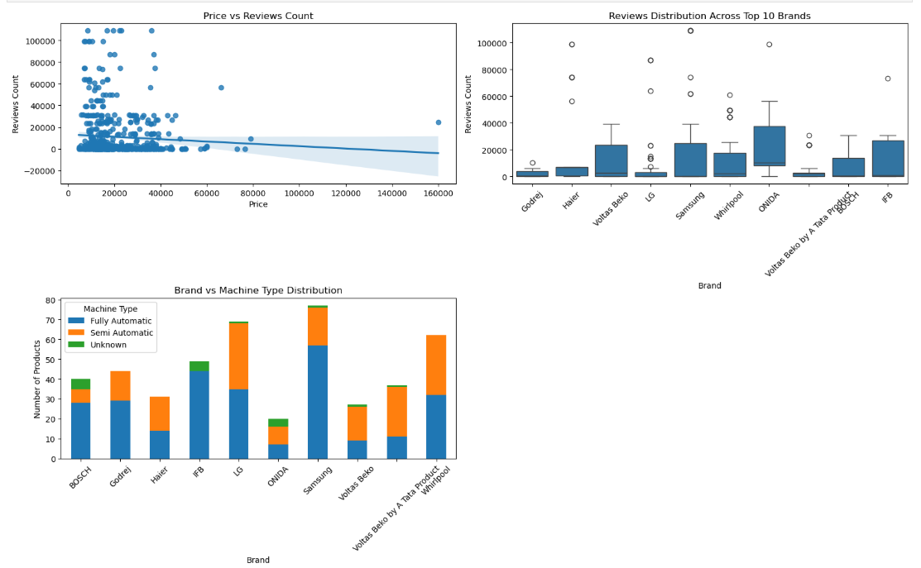
TEST CASES – EDA PROJECT (Washing Machine Data)

Slide 16
Test Cases
Brand × Price × Reviews (Comparative Analysis)
Higher price does not lead to higher reviews.
Customer engagement is weakly related to price.
Brand vs Reviews (ANOVA Test)
Review counts vary significantly across brands.
Some brands consistently receive higher customer engagement.
Brand vs Machine type(chi –Square test)
Brands specialize in specific machine types.
Fully automatic machines dominate across most brands.
Overall Insight (Closing Line):
These charts together show that brand influence and product strategy matter more than price in driving customer reviews and engagement.

Slide 17
Conclusion
Future Scope
Price alone does not drive reviews
Brand reputation is the strongest factor
Mid-capacity, semi-automatic machines dominate the market
Businesses should focus on brand positioning and value pricing
Add ratings and sales data for deeper insights
Predict reviews using ML models
Customer sentiment analysis from review text
Price optimization models

Slide 18
Applications
Helps companies identify high-engagement brands and products
Supports targeted marketing and promotional campaigns
Improves pricing and discount strategy decisions
Helps in choosing the right products to keep in stock
Improves demand planning using review trends

Slide 19
Recommendations
Focus on strengthening brand reputation and visibility
Adopt value-based pricing over premium-only strategies
Optimize product offerings by machine type and capacity
Improve low-performing products using review insights
Continuously use data insights for strategic decisions

Slide 20


Slide 21

THANK YOU

